Slide 1
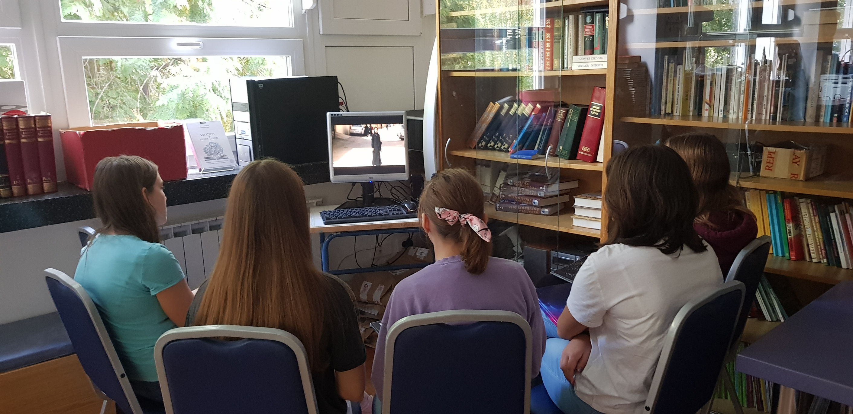

IMAGENDER
OSNOVNA SKOLA DOBRISE CESARICA ZAGREB

Slide 2


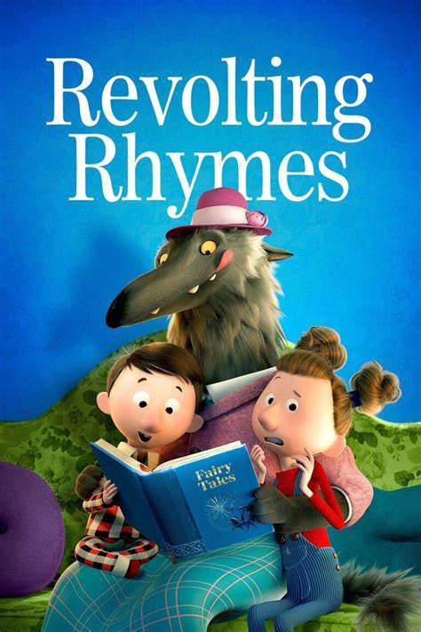

  What do you think about XX character position?
  What is typically male?
  What is typically feminine?
  How do you know what is typically female and what is typically male?
  What pictures and quotes would best describe you?
  There are things you would like to do but do not do because you think a boy or a girl can't do them?
  Why?
  What would you like to say about the film?
  How did you feel after the film?
  What did you feel during the film?
  Are there any scenes or themes in the film you would like to talk about?
  What questions were left unanswered in the film?
  Is there anything you did not understand?

Slide 3




